Slide 1


PSG COLLEGE OF TECHNOLOGY
DEPARTMENT OF INFORMATION TECHNOLOGY
SECURE OTA SOFTWARE UPDATE FOR SMART VEHICLES

Slide 2
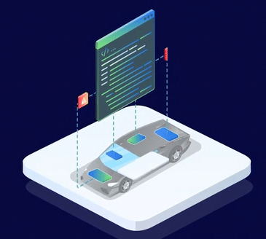
INTRODUCTION
Traditionally, software updates are performed in person at service centers.
OEMs are trying a new approach by sending and installing software updates over the air (the internet) to the cars directly
OTA car updates eliminates the need for software-related recalls and make software updates easy and seamless
Notes:
https://autocrypt.io/what-is-over-the-air-car-update/

Slide 3
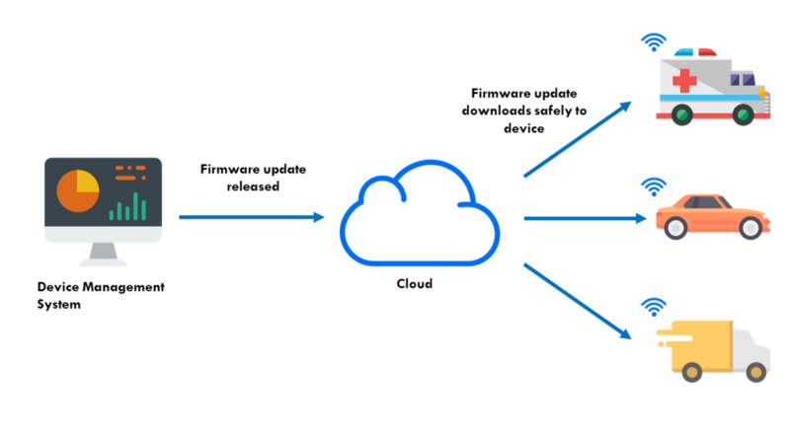
PROBLEM STATEMENT
The overall objective of this project is to provide enhanced features and updated security mechanisms in smart vehicles, because software updates are an integral part of the overall user experience as they contain important feature enhancements and crucial security patches.
Notes:
https://autocrypt.io/what-is-over-the-air-car-update/

Slide 4

SCOPE AND MOTIVATION
Avoids physical recalls
Convenient and economically feasible
Lesser time
Improved safety
Lower cost
Increased value

Slide 5
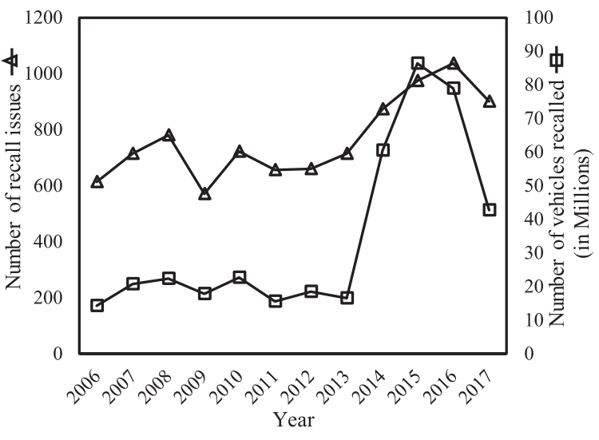
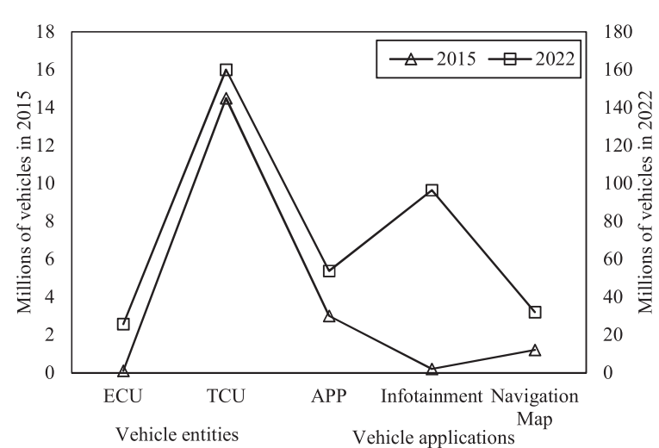
DEMAND FOR OTA
Halder, S., Ghosal, A., & Conti, M. (2020). Secure over-the-air software updates in connected vehicles: A survey. Computer Networks, 178, 107343.
Comparison of the number of recall issues with number of Vehicles recalled
(2006 to 2017)
Adaptation of OTA process for updating software in different vehicle entities and application in millions of vehicles (2015–2022)

Slide 6
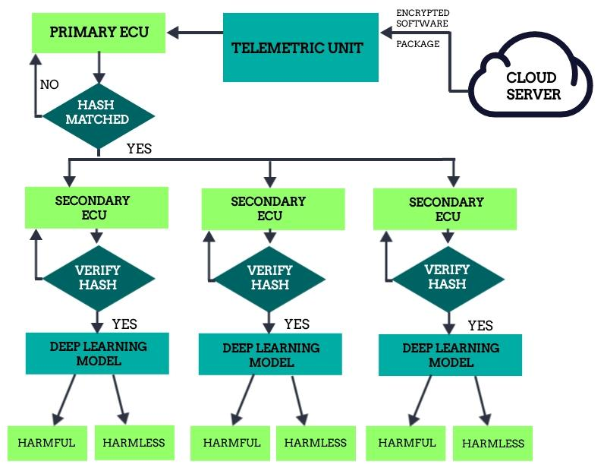
METHODOLOGY

Slide 7

MODULES IDENTIFIED
Encryption
Hashing
Decryption
CNN
Pre-Trained Models
Evaluation Metrics
ENCRYPTION/DECRYPTION | CNN/PRE-TRAINED MODELS
Encryption Time | Accuracy
Decryption time | Precision
Throughput | Recall
 | F1 score

Slide 8
AVAILABLE DATASETS
Malicious URLs dataset - Contains 651,191 URLs out of which 428103 benign or safe URLs, 96457 defacement URLs, 94111 phishing URLs, and 32520 malware URLs.
Benign & Malicious PE Files - Contains benign and malicious data from Portable Executable format. It contains 79 column.
Malware Executable Detection - Created using hybrid features (binary hexadecimal + DLL calls). The file consist of total 373 samples of which 301 are malicious files while rest 72 are non-malicious.
Dataset of Malicious and Benign Web Pages - Contains 21 columns like the details of url like the length, ip address, domain in .csv format .

Slide 9
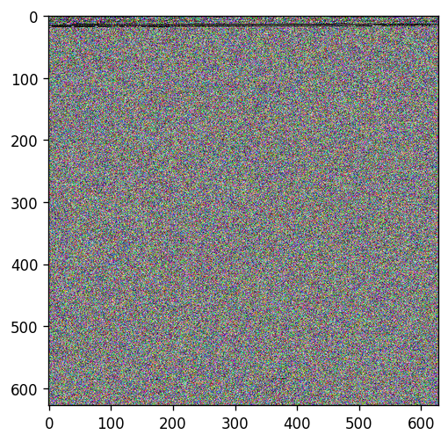
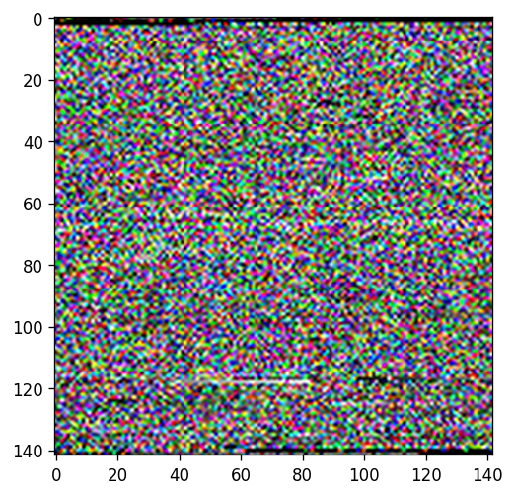
TRAINING DATASET
Utilizes the malware classification dataset obtained from kaggle
Dataset was developed using mallook to build picture representations of malware (malicious) and conventional software Portable Executables (PEs) (benign)
Total size of 11.2 GB
DPI versions of the images in 120, 300, 600, and 1200 DPI
Benign lanczos_120
Malicious lanczos_120

Slide 10
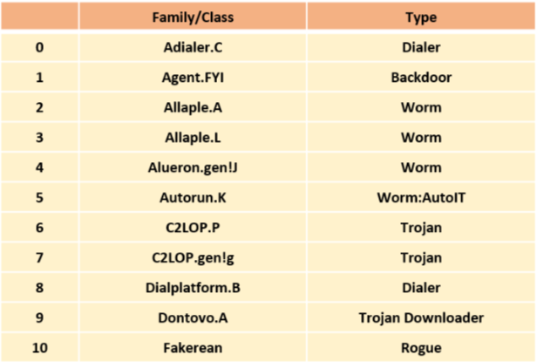
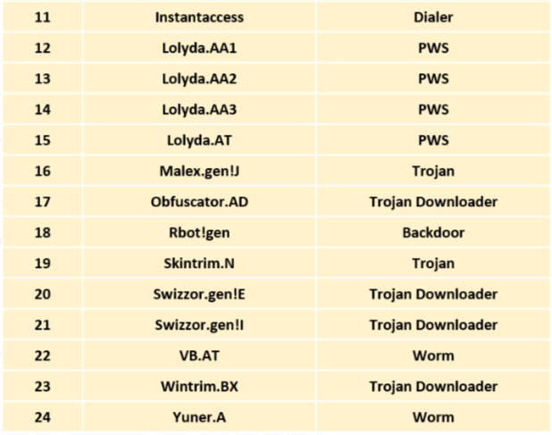
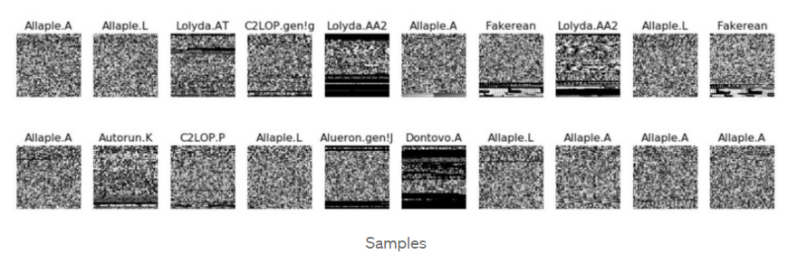
TESTING DATASET
The Malimg Dataset contains 9339 malware images, belonging to 25 families/classes

Slide 11
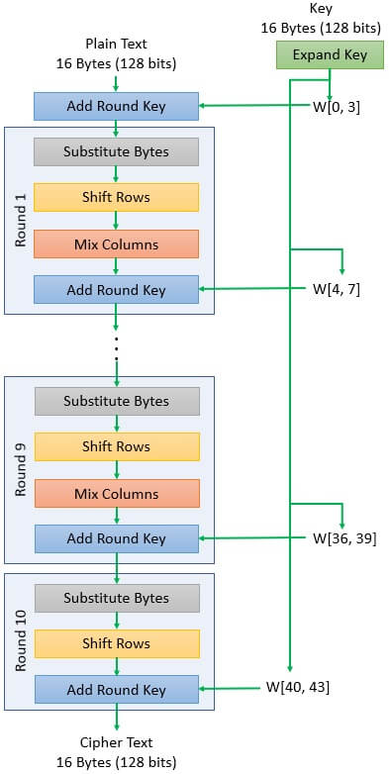
ENCRYPTION AND DECRYPTION
The process of transforming a plaintext message into a meaningless message is known as encryption.
Decryption is the process of converting an encrypted code or data into a form that a human or machine can comprehend and read.
AES Encryption algorithm is implemented.
Encrypts data in blocks of 128 bits each.
The whole algorithm operates on a 4x4 matrix of bytes.
The first rounds consist of four distinct transformation functions: Sub Bytes, Shift Rows, Mix Columns, and Add Round Key. The final round contains three transformations.

Slide 12
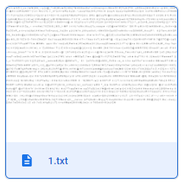
ALGORITHM
Encode the images using base64
Output string
Input images
To AES Algorithm
ENCRYPTION
Image C of size (w, h) with pixel data
DECRYPTION
Splitting into two parts(R and P)
Finding out the exact value%26
Adding it to creating Cipher Text
Cipher Text

Slide 13
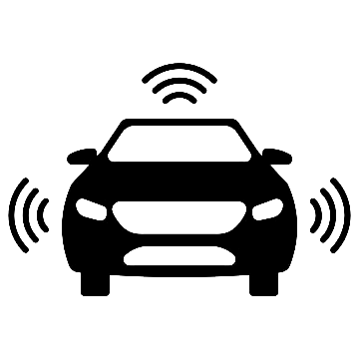
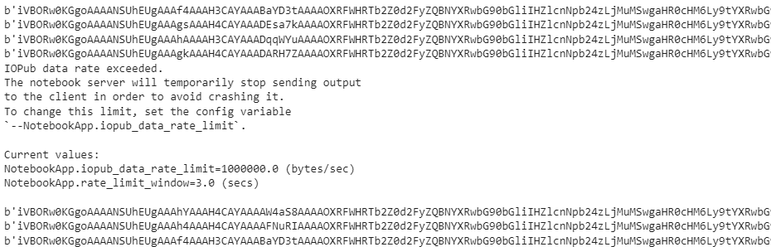
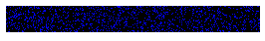

ENCRYPTION OUTPUT
Image to String format
Encrypted Image
Image File - A
Image File - B

Slide 14
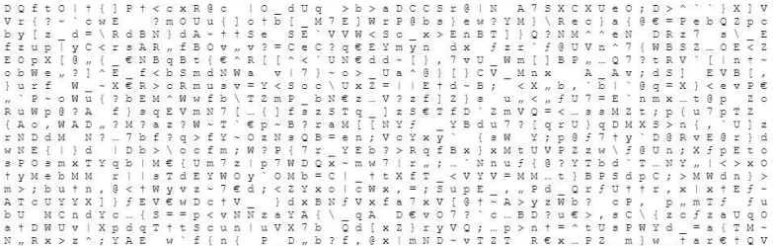

CIPHER TEXT OUTPUT

Slide 15
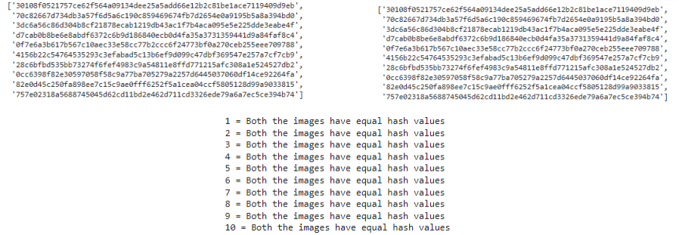
HASHING OUTPUT
Input Image Hash
Decrypted Output Image Hash

Slide 16
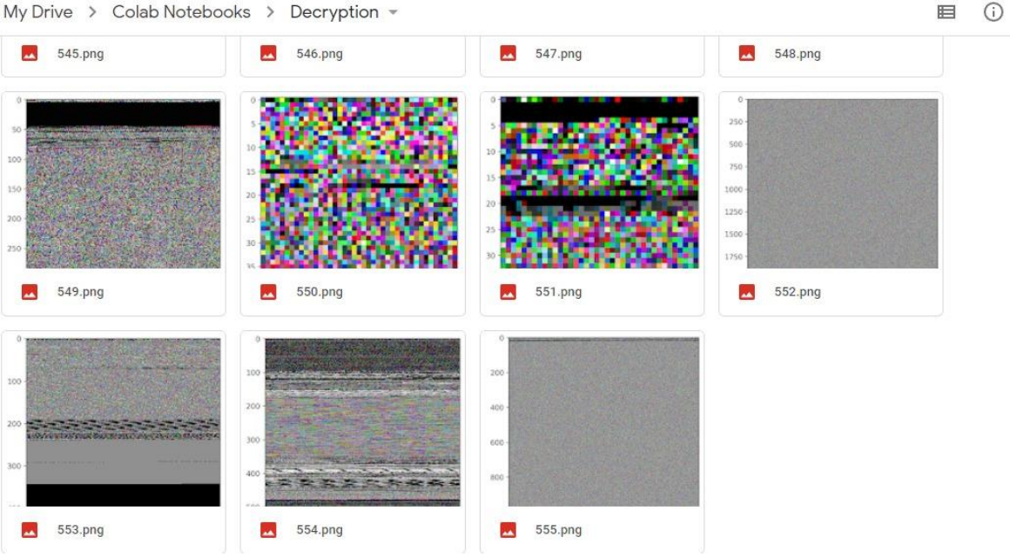
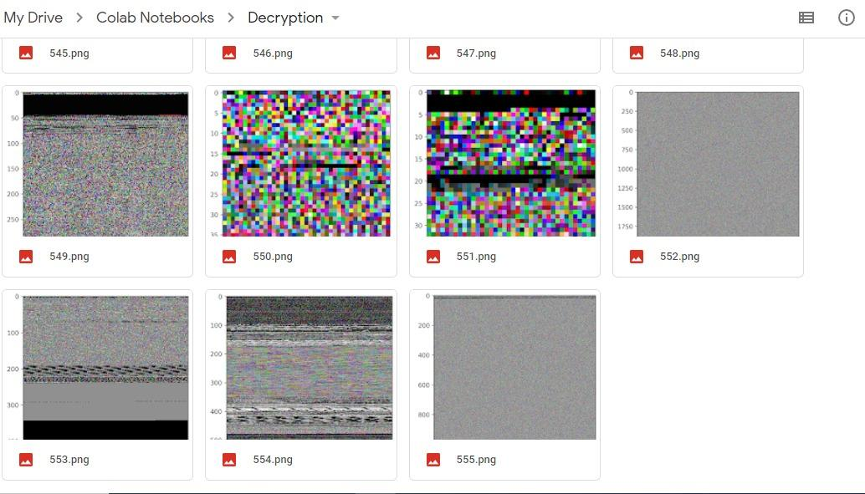
DECRYPTION OUTPUT

Slide 17
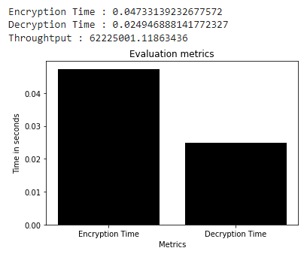
Encryption Time: The encryption time is the time that an encryption algorithm takes to produce a cipher text from a plaintext. It is measured in seconds
Decryption Time: The decryption time is the time that a decryption algorithm takes to produce a plaintext from a cipher text. It is measured in seconds
Throughput: The throughput of an encryption or decryption defines the speed of encryption. It is in bytes per second.
EVALUATION METRICS
Throughput = Bytes of total plain text / Encryption Time

Slide 18
COMPARISON OF RESULTS
ALGORITHM | ENCRYPTION TIME (seconds) | DECRYPTION TIME (seconds)
AES | 4.143 | 4.413
AES with Visual Cryptography | 0.047 | 0.024
The total complexity of the algorithm = AES (Encoded Image) + SHA (Key) + (Key Length * 26)
= O (AES(Image))

Slide 19
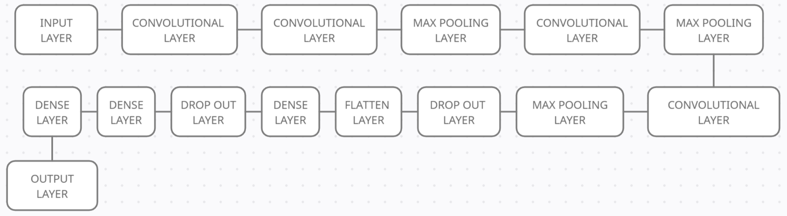
In deep learning, a convolutional neural network is a class of artificial neural network, most commonly applied to analyze visual imagery
CNN's are really effective for image classification as the concept of dimensionality reduction suits the huge number of parameters in an image
CONVOLUTION NEURAL NETWORK

Slide 20
Precision Score: The model precision score is a measure of the model's ability to properly predict positives out of all the positive predictions it has made
Precision Score=TP/(FP+TP)
Recall Score: The model's ability to properly forecast positives out of real positives is measured by the model recall score
Recall Score=TP/(FN+TP)
F1 Score: The model score as a function of accuracy and recall is represented by the model F1 score
F1 Score=2*Precision Score*Recall Score/ (Precision Score+Recall Score)
Accuracy Score: The model's ability to accurately anticipate both positives and negatives out of all the predictions is represented by the model's accuracy score
Accuracy Score=(TP+TN)/(TP+FN+TN+FP)
EVALUATION METRICS

Slide 21
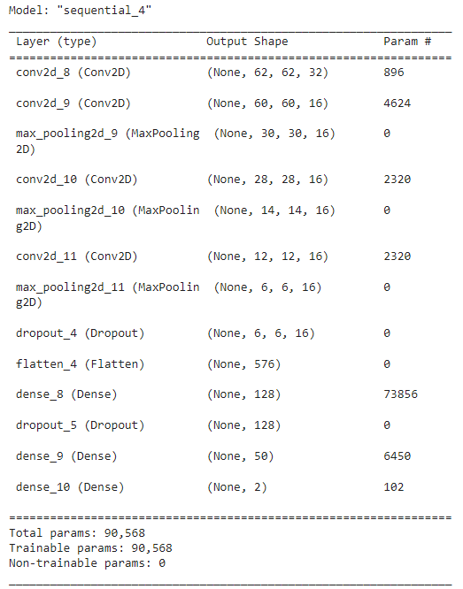
Image size : (64,64,3)
Optimizer : Adam
Layers : Convolution layers , MaxPooling2D, Dropout, Flatten, Dense
Loss : categorical_crossentropy
Implementation:
STEP 1: Choose a Dataset and pre process
STEP 2: Analyze the dataset
STEP 3: Split train and test
STEP 4: Define, compile and train the CNN Model using Keras
STEP 5: Evaluation metrics of the CNN model.
CNN

Slide 22
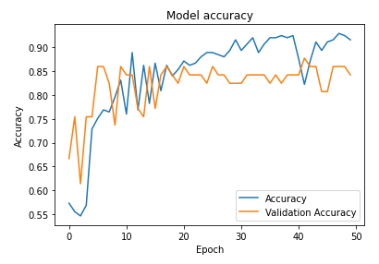
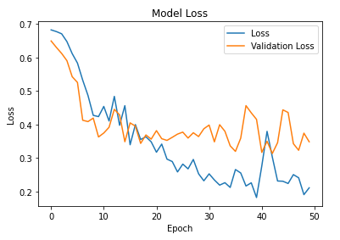
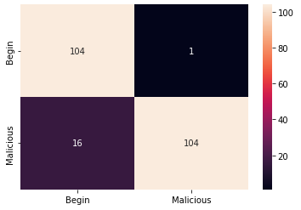
RESULTS OF CNN
Accuracy - 92.44
Confusion Matrix
Loss - 17.53

Slide 23
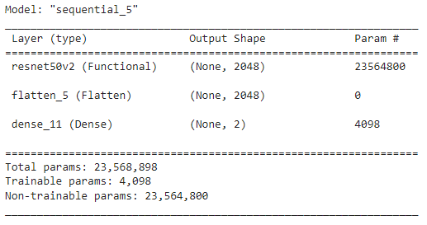
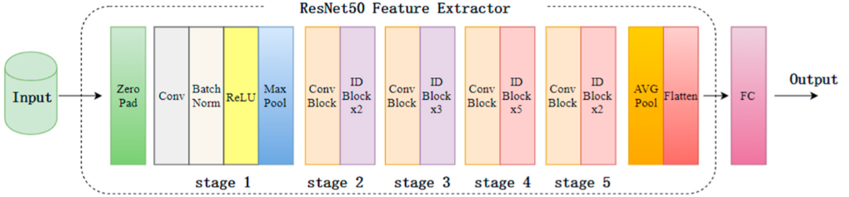
RESNET50V2
The ResNet-50 model is divided into five stages each comprising a convolutional and identity block.
Each convolution block has 3 levels
Each identity block has 3 layers as well.
There are around 23 million trainable parameters in the ResNet-50.

Slide 24
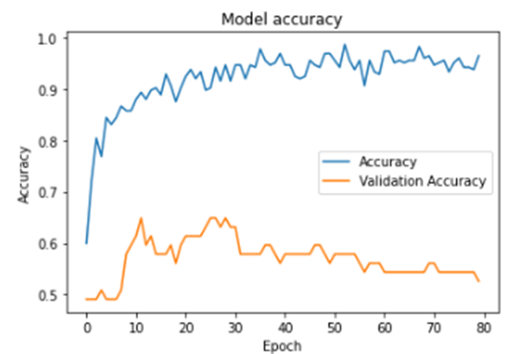
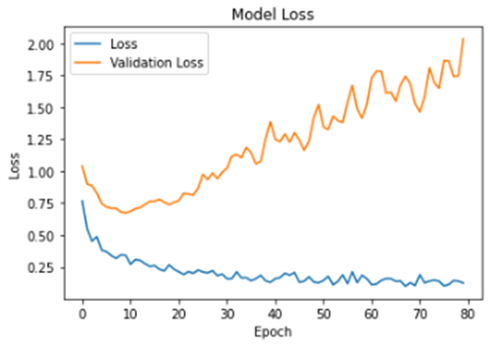
RESULT OF RESNET50V2
Accuracy - 0.9689
Loss -0.1289

Slide 25
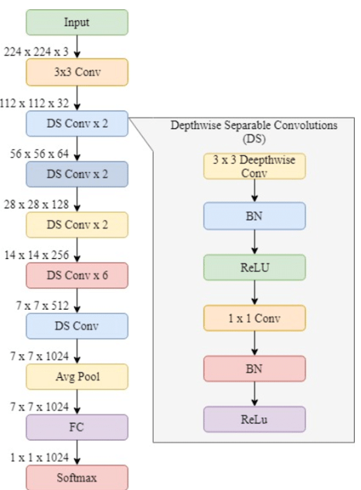
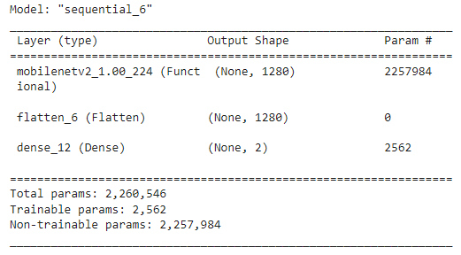
MOBILNETV2
MobileNetV2 is built on an inverted residual structure, with residual connections between bottleneck levels.
Has 53-layer deep CNN
The network's picture input size is 224 × 224 pixels

Slide 26
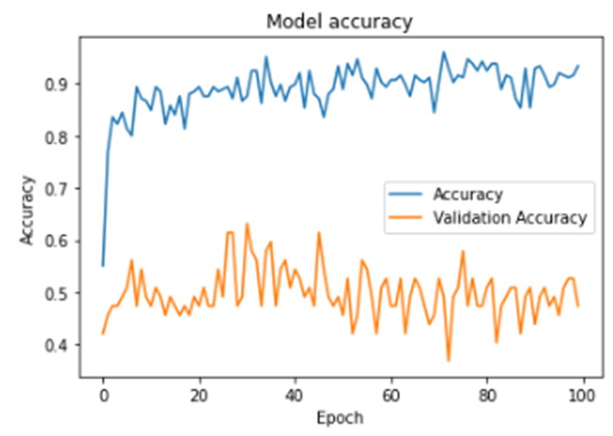
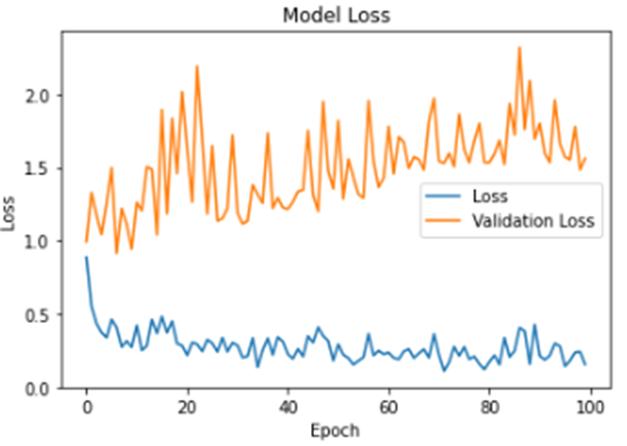
RESULT OF MOBILNETV2
Accuracy - 0.9289
Loss - 0.1760

Slide 27
COMPARISON OF RESULTS
DATASET NAME | ALGORITHM | ACCURACY | PRECISION | RECALL | F1
MALWARE CLASSIFICATION DATASET | CNN | 0.92 | 0.99 | 0.87 | 0.92
 | RESNET50V2 | 0.96 | 0.77 | 0.47 | 0.58
 | MOBILENETV2 | 0.92 | 0.54 | 0.93 | 0.68
MALIMG_PAPER_DATASET | CNN | 0.84 | 0.92 | 0.83 | 0.84
 | RESNET50V2 | 0.92 | 0.64 | 0.42 | 0.52
 | MOBILENET V2 | 0.95 | 0.56 | 0.95 | 0.65

Slide 28
REFERENCE
[1] Anam Qureshia, Murk Marvib, Jawwad Ahmed Shamsia, and Adnan Aijazc, “eUF: A framework for detecting over-the-air malicious updates in autonomous vehicles”, Journal of King Saud University,26 May 2021.
[2] Amrita Ghosal, Subir Halder, and Mauro Conti, “STRIDE: Scalable and Secure Over-The-Air Software Update Scheme for Autonomous Vehicles”, ICC 2020 - 2020 IEEE International Conference on Communications (ICC), 27 July 2020.
[3] Mohammad khodari, Abhimanyu Rwat,Mikael Asplund, Andrei Gurtov," Decentralized Firmware Attestation for In- Vehicle Networks", ACM Transactions on Cyber Physical Systems, July 2019.
[4] Marco Steger, Carlo ALberto Boano, Thomas Niedermayr, Michael Karner,Joachim Hillebrand, Kay Romer and Werner Rom," An Efficient and Secure Automative Wireless Software Update Framework", IEEE transactions on industrial informatics – special section on industrial communication technologies and systems, May 2018.

Slide 29
REFERENCE
[5] Nicholas Ayres, Lipika Deka and Daniel Paluszczyszyn,"Continuous Automotive Software Updates through Container image Layers",MDPI,20 March 2021.
[6] Anway Mukherjee, Ryan Gerdes and Tam Chantem,"Trusted Verification of Over-the-Air(OTA) Secure Software Updates on COTS Embedded System", 25 February 2021.
[7] Muzaffar Khurram, Hemanth kumar, Adi Chandak, Varun Sarwade, Nitu Arora, Tony Quach,"Enhancing connected car adoption: Security and over the air update framework", IEEE 3rd World Forum on Internet Of things(WF-IOT), December 2016.
[8] RizkyRiyaldhi, Rojali, Aditya Kurniawan, “Improvement of Advanced Encryption Standard Algorithm With Shift Row and S.Box Modification Mapping in Mix Column”,Bina Nusantara Univesity, 13 October 2017.

Slide 30
THANK YOU!!

